Slide 1
CS6290
Caches

Slide 2
Locality and Caches
Data Locality
  Temporal: if data item needed now,
  it is likely to be needed again in near future
  Spatial: if data item needed now,
  nearby data likely to be needed in near future
Exploiting Locality: Caches
  Keep recently used data
  in fast memory close to the processor
  Also bring nearby data there

Slide 3
Storage Hierarchy and Locality
Capacity +
Speed -
Disk
SRAM Cache
Main Memory
Row buffer
L3 Cache
L2 Cache
ITLB
Instruction Cache
Data Cache
DTLB
Register File
Bypass Network
Speed +
Capacity -

Slide 4
Memory Latency is Long
60-100ns not totally uncommon
Quick back-of-the-envelope calculation:
  2GHz CPU
  → 0.5ns / cycle
  100ns memory → 200 cycle memory latency!
Solution: Caches

Slide 5
Cache Basics
Fast (but small) memory close to processor
When data referenced
  If in cache, use cache instead of memory
  If not in cache, bring into cache
  (actually, bring entire block of data, too)
  Maybe have to kick something else out to do it!
Important decisions
  Placement: where in the cache can a block go?
  Identification: how do we find a block in cache?
  Replacement: what to kick out to make room in cache?
  Write policy: What do we do about stores?
Key: Optimize the
average memory
access latency

Slide 6
Cache Basics
Cache consists of block-sized lines
  Line size typically power of two
  Typically 16 to 128 bytes in size
Example
  Suppose block size is 128 bytes
    Lowest seven bits determine offset within block
  Read data at address A=0x7fffa3f4
  Address begins to block with base address 0x7fffa380

Slide 7
Cache Placement
Placement
  Which memory blocks are allowed
  into which cache lines
Placement Policies
  Direct mapped (block can go to only one line)
  Fully Associative (block can go to any line)
  Set-associative (block can go to one of N lines)
    E.g., if N=4, the cache is 4-way set associative
    Other two policies are extremes of this
    (E.g., if N=1 we get a direct-mapped cache)

Slide 8
Cache Identification
When address referenced, need to
  Find whether its data is in the cache
  If it is, find where in the cache
  This is called a cache lookup
Each cache line must have
  A valid bit (1 if line has data, 0 if line empty)
    We also say the cache line is valid or invalid
  A tag to identify which block is in the line
  (if line is valid)

Slide 9
Cache Replacement
Need a free line to insert new block
  Which block should we kick out?
Several strategies
  Random (randomly selected line)
  FIFO (line that has been in cache the longest)
  LRU (least recently used line)
  LRU Approximations
  NMRU
  LFU

Slide 10
Implementing LRU
Have LRU counter for each line in a set
When line accessed
  Get old value X of its counter
  Set its counter to max value
  For every other line in the set
    If counter larger than X, decrement it
When replacement needed
  Select line whose counter is 0

Slide 11
Approximating LRU
LRU is pretty complicated (esp. for many ways)
  Access and possibly update all counters in a set
  on every access (not just replacement)
Need something simpler and faster
  But still close to LRU
NMRU – Not Most Recently Used
  The entire set has one MRU pointer
  Points to last-accessed line in the set
  Replacement:
  Randomly select a non-MRU line

Slide 12
Write Policy
Do we allocate cache lines on a write?
  Write-allocate
    A write miss brings block into cache
  No-write-allocate
    A write miss leaves cache as it was
Do we update memory on writes?
  Write-through
    Memory immediately updated on each write
  Write-back
    Memory updated when line replaced

Slide 13
Write-Back Caches
Need a Dirty bit for each line
  A dirty line has more recent data than memory
Line starts as clean (not dirty)
Line becomes dirty on first write to it
  Memory not updated yet, cache has the only up-to-date copy of data for a dirty line
Replacing a dirty line
  Must write data back to memory (write-back)

Slide 14
Example - Cache Lookup

Slide 15
Example - Cache Replacement

Slide 16
Cache Performance
Miss rate
  Fraction of memory accesses that miss in cache
  Hit rate = 1 – miss rate
Average memory access time
  AMAT = hit time + miss rate * miss penalty
Memory stall cycles
CPUtime = CycleTime x (Cycles_{Exec} + Cycles_{MemoryStall})
Cycles_{MemoryStall} = CacheMisses x (MissLatency_{Total} – MissLatency_{Overlapped})

Slide 17
Improving Cache Performance
AMAT = hit time + miss rate * miss penalty
  Reduce miss penalty
  Reduce miss rate
  Reduce hit time
Cycles_{MemoryStall} = CacheMisses x (MissLatency_{Total} – MissLatency_{Overlapped})
  Increase overlapped miss latency

Slide 18
Reducing Cache Miss Penalty (1)
Multilevel caches
  Very Fast, small Level 1 (L1) cache
  Fast, not so small Level 2 (L2) cache
  May also have slower, large L3 cache, etc.
Why does this help?
  Miss in L1 cache can hit in L2 cache, etc.
    AMAT = HitTime_{L1}+MissRate_{L1}MissPenalty_{L1}
    MissPenalty_{L1}= HitTime_{L2}+MissRate_{L2}MissPenalty_{L2}
    MissPenalty_{L2}= HitTime_{L3}+MissRate_{L3}MissPenalty_{L3}

Slide 19
Multilevel Caches
Global vs. Local Miss Rate
  Global L2 Miss Rate
  # of L2 Misses / # of All Memory Refs
  Local Miss Rate
  # of L2 Misses / # of L1 Misses
  (only L1 misses actually get to the L2 cache)
  MPKI often used (normalize against number of instructions)
    Allows comparisons against different types of events
Exclusion Property
  If block is in L1 cache, it is never in L2 cache
  Saves some L2 space
Inclusion Property
  If block A is in L1 cache, it must also be in L2 cache

Slide 20
Reducing Cache Miss Penalty (2)
Early Restart & Critical Word First
  Block transfer takes time (bus too narrow)
  Give data to loads before entire block arrive
Early restart
  When needed word arrives, let processor use it
  Then continue block transfer to fill cache line
Critical Word First
  Transfer loaded word first, then the rest of block
  (with wrap-around to get the entire block)
  Use with early restart to let processor go ASAP

Slide 21
Reducing Cache Miss Penalty (3)
Increase Load Miss Priority
  Loads can have dependent instructions
  If a load misses and a store needs to go to memory, let the load miss go first
  Need a write buffer to remember stores
Merging Write Buffer
  If multiple write misses to the same block, combine them in the write buffer
  Use block-write instead of a many small writes

Slide 22
Kinds of Cache Misses
The “3 Cs”
  Compulsory: have to have these
    Miss the first time each block is accessed
  Capacity: due to limited cache capacity
    Would not have them if cache size was infinite
  Conflict: due to limited associativity
    Would not have them if cache was fully associative

Slide 23
Reducing Cache Miss Penalty (4)
Victim Caches
  Recently kicked-out blocks kept in small cache
  If we miss on those blocks, can get them fast
  Why does it work: conflict misses
    Misses that we have in our N-way set-assoc cache, but would not have if the cache was fully associative
  Example: direct-mapped L1 cache and
  a 16-line fully associative victim cache
    Victim cache prevents thrashing when several “popular” blocks want to go to the same entry

Slide 24
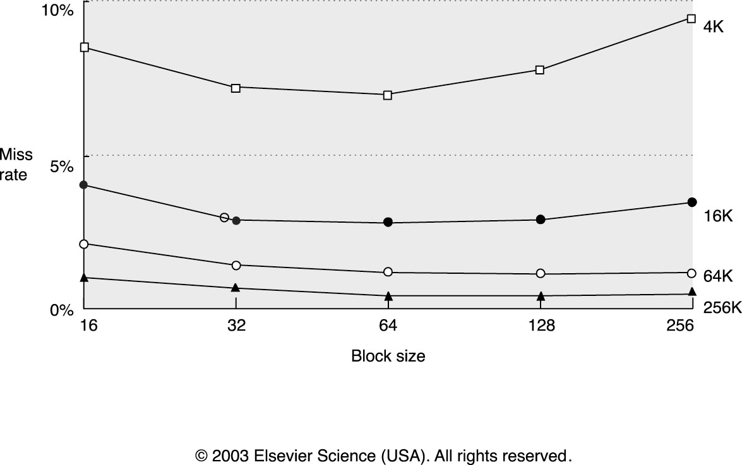
Reducing Cache Miss Rate (1)
Larger blocks
  Helps if there is more spatial locality

Slide 25
Reducing Cache Miss Rate (2)
Larger caches
  Fewer capacity misses, but longer hit latency!
Higher Associativity
  Fewer conflict misses, but longer hit latency
Way Prediction
  Speeds up set-associative caches
  Predict which of N ways has our data,
  fast access as direct-mapped cache
  If mispredicted, access again as set-assoc cache

Slide 26
Reducing Cache Miss Rate (2)
Pseudo Associative Caches
  Similar to way prediction
  Start with direct mapped cache
  If miss on “primary” entry, try another entry
Compiler optimizations
  Loop interchange
  Blocking

Slide 27
Loop Interchange
For loops over multi-dimensional arrays
  Example: matrices (2-dim arrays)
Change order of iteration to match layout
  Gets better spatial locality
  Layout in C: last index changes first
for(j=0;j<10000;j++)
for(i=0;i<40000;i++)
c[i][j]=a[i][j]+b[i][j];
for(i=0;i<40000;i++)
for(j=0;j<10000;j++)
c[i][j]=a[i][j]+b[i][j];
a[i][j] and a[i+1][j]
are 10000 elements apart
a[i][j] and a[i][j+1]
are next to each other

Slide 28
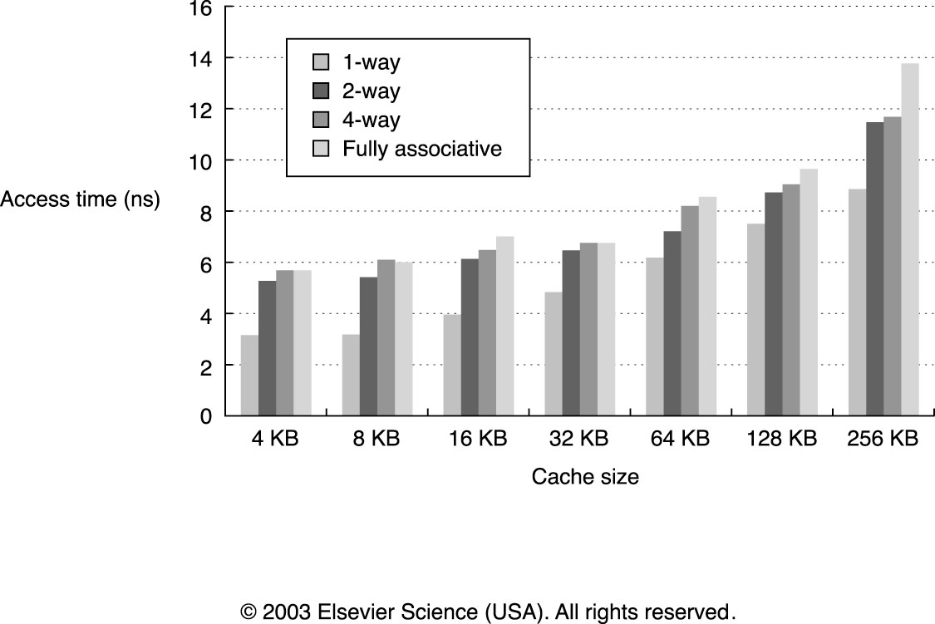
Reducing Hit Time (1)
Small & Simple Caches are faster

Slide 29
Reducing Hit Time (2)
Avoid address translation on cache hits
Software uses virtual addresses,
memory accessed using physical addresses
  Details of this later (virtual memory)
HW must translate virtual to physical
  Normally the first thing we do
  Caches accessed using physical address
  Wait for translation before cache lookup
Idea: index cache using virtual address

Slide 30
Reducing Hit Time (3)
Pipelined Caches
  Improves bandwidth, but not latency
  Essential for L1 caches at high frequency
    Even small caches have 2-3 cycle latency at N GHz
  Also used in many L2 caches
Trace Caches
  For instruction caches

Slide 31
Hiding Miss Latency
Idea: overlap miss latency with useful work
  Also called “latency hiding”
Non-blocking caches
  A blocking cache services one access at a time
    While miss serviced, other accesses blocked (wait)
  Non-blocking caches remove this limitation
    While miss serviced, can process other requests
Prefetching
  Predict what will be needed and get it ahead of time

Slide 32
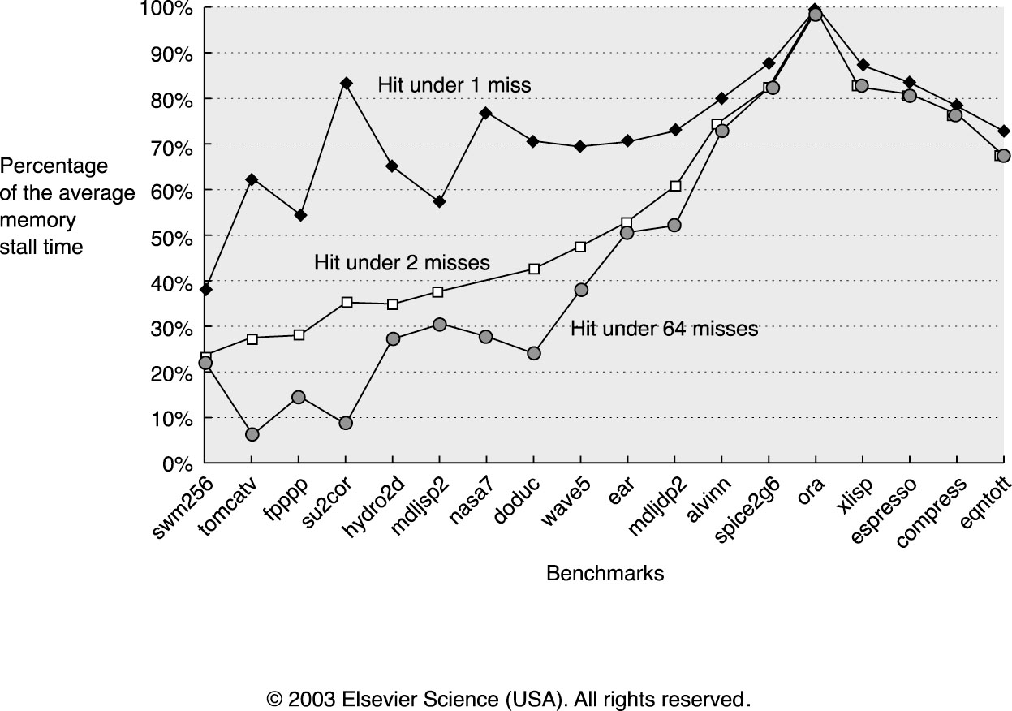
Non-Blocking Caches
Hit Under Miss
  Allow cache hits while one miss in progress
  But another miss has to wait
Miss Under Miss, Hit Under Multiple Misses
  Allow hits and misses when other misses in progress
  Memory system must allow multiple pending requests

Slide 33
Prefetching
Predict future misses and get data into cache
  If access does happen, we have a hit now
  (or a partial miss, if data is on the way)
  If access does not happen, cache pollution
  (replaced other data with junk we don’t need)
To avoid pollution, prefetch buffers
  Pollution a big problem for small caches
  Have a small separate buffer for prefetches
    When we do access it, put data in cache
    If we don’t access it, cache not polluted

Slide 34
Software Prefetching
Two flavors: register prefetch and cache prefetch
Each flavor can be faulting or non-faulting
  If address bad, does it create exceptions?
Faulting register prefetch is binding
  It is a normal load, address must be OK, uses register
Not faulting cache prefetch is non-binding
  If address bad, becomes a NOP
  Does not affect register state
  Has more overhead (load still there),
  ISA change (prefetch instruction),
  complicates cache (prefetches and loads different)

